Slide 1
Convex Hull
Valentina Korzhova
Office ENB 343 G
korzhova@cse.usf.edu

Slide 2
Objectives
Convex partitioning
Definition of convex hull
Extreme points
Gift-wrapping algorithm

Slide 3
Convex Partitioning
Polygon partitioning is an important preprocessing step for many geometric algorithms
Partitioning a polygon means completely dividing the interior into nonoverlapping pieces.
Covering a polygon means that our decomposition is permitted to contain mutually overlapping pieces.
An issue associated with polygon decomposition is whether we are allowed to add Steiner vertices (either by splitting edges or adding interior points) or whether we are restricted to adding chords between two existing vertices.

Slide 4
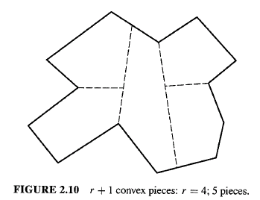
Convex Partitioning
Competing Goals:
minimize number of convex pieces
minimize partitioning time
Add (Steiner) points or just use diagonals and not add points?
Adding segments with Steiner points.
r = number of reflex vertices
Adding only diagonals.

Slide 5
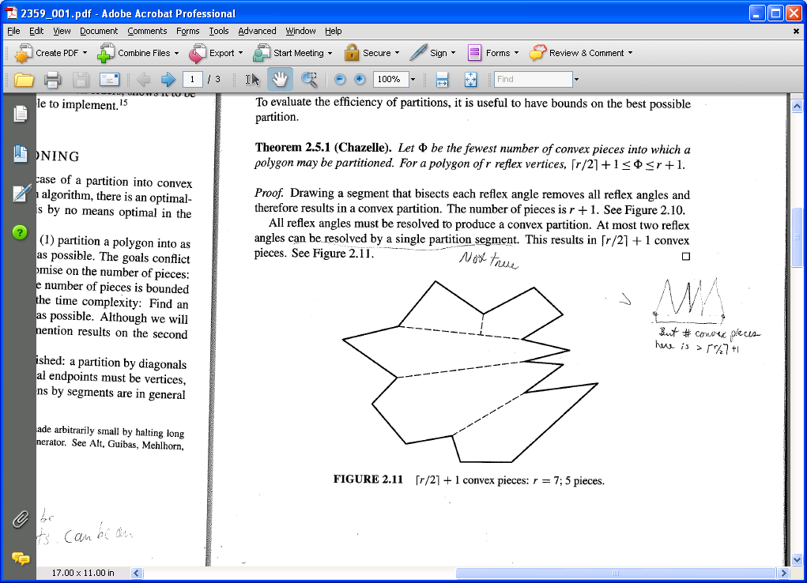
Convex Partitioning
Theorem (Chazelle): Let Φ be the fewest number of convex pieces into which a polygon may be partitioned. For a polygon of r reflex vertices:
Lower bound:
Must eliminate all reflex vertices. Single segment resolves at most 2 reflex angles.
Upper bound:
Bisect each reflex angle.

Slide 6
Convex Partitioning
Hertel-Mehlhorn’s Algorithm (1983):
Start with any triangulation.
Iteratively remove inessential diagonals.
Essential diagonal d for vertex v
if removing d creates non-convex piece at v.
Can be done in O(n) time with the use of appropriate data structures
The only issue is how far from the optimum might it be

Slide 7
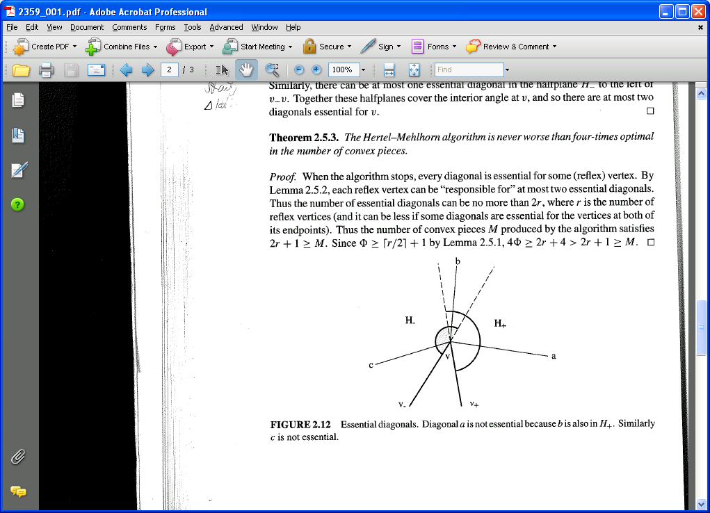

Convex Partitioning
Lemma: There can be at most 2 diagonals essential for any reflex vertex.
Proof. Let v be a reflex vertex and $v_{+}$ and $v_{−}$ its adjacent vertices. There can be at most one essential diagonal in the halfplane $H_{+}$ to the left of $vv_{+}$. If there were two , the one closest to $vv_{+}$ can be removed. Similarly there can be at most one essential diagonal in the half-line $H_{−}$ to the left of $vv_{−}$. Together these halfplanes cover the interior angle at v. Thus, there at most two diagonals essential to v

Slide 8
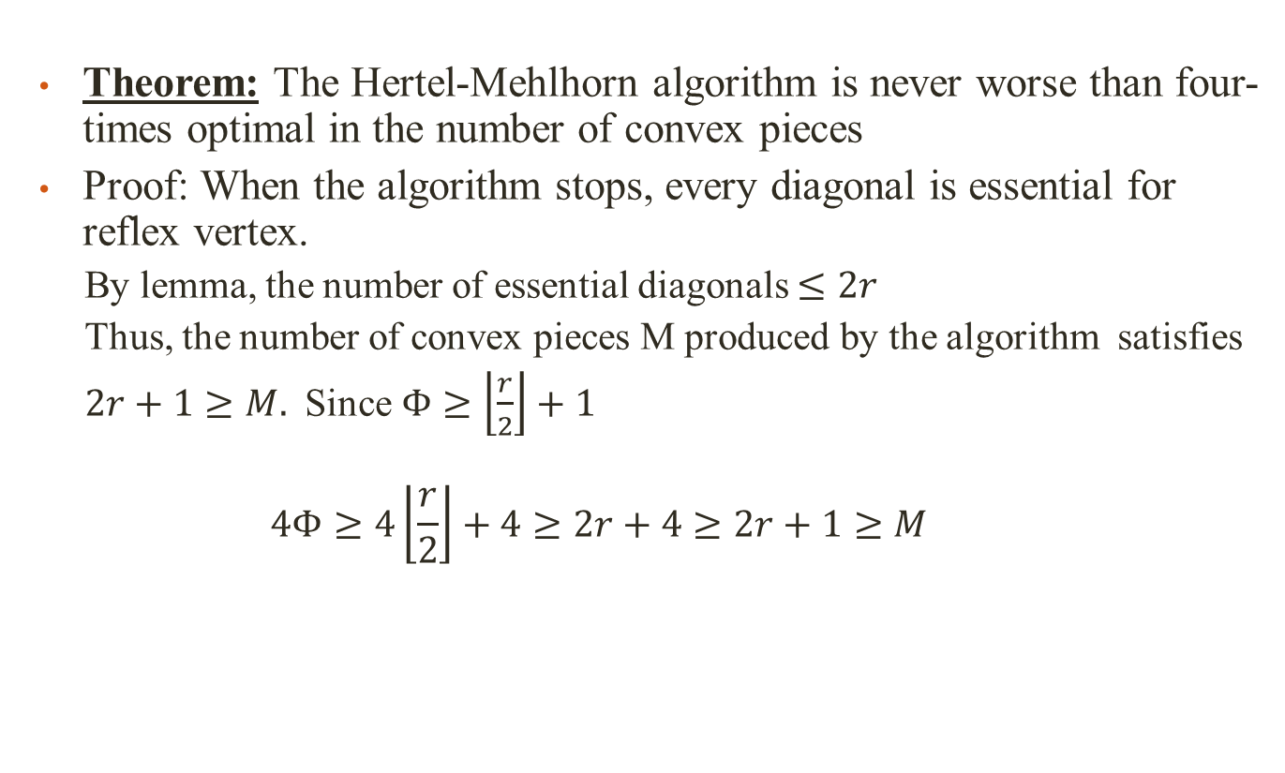
Convex Partitioning
Theorem: The Hertel-Mehlhorn algorithm is never worse than four-times optimal in the number of convex pieces
Proof: When the algorithm stops, every diagonal is essential for reflex vertex.
By lemma, the number of essential diagonals $≤2r$
Thus, the number of convex pieces M produced by the algorithm satisfies
$2r+1≥M.$ Since $Φ≥\left\lfloor \frac{r}{2}\right\rfloor +1$
$$4Φ≥4\left\lfloor \frac{r}{2}\right\rfloor +4≥2r+4≥2r+1≥M$$

Slide 9
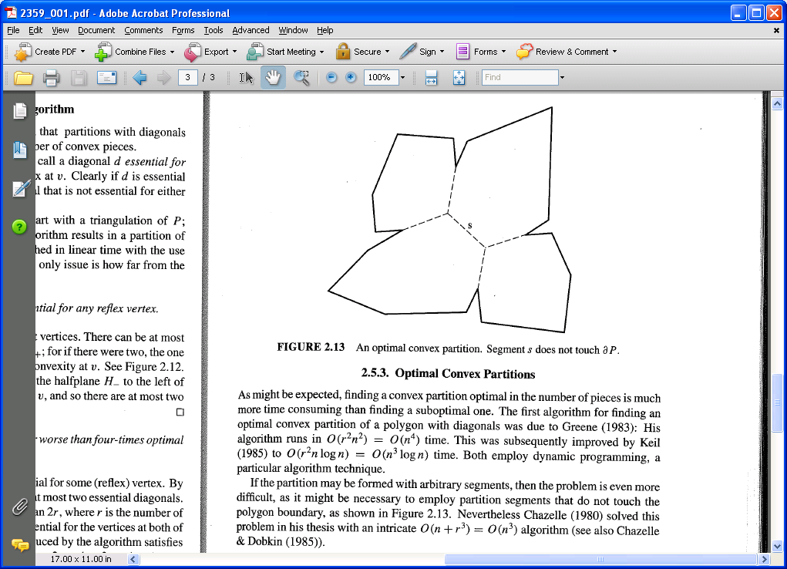
Algorithms for Optimal Convex Partitioning of a Polygon
Optimal convex partition using diagonals
Greene (1983): O(n⁴) time with dynamic programming
Keil (1985): O(n³logn) time with dynamic programming
Optimal convex partition using arbitrary segments
Chazelle (1980) : O(n³) time

Slide 10
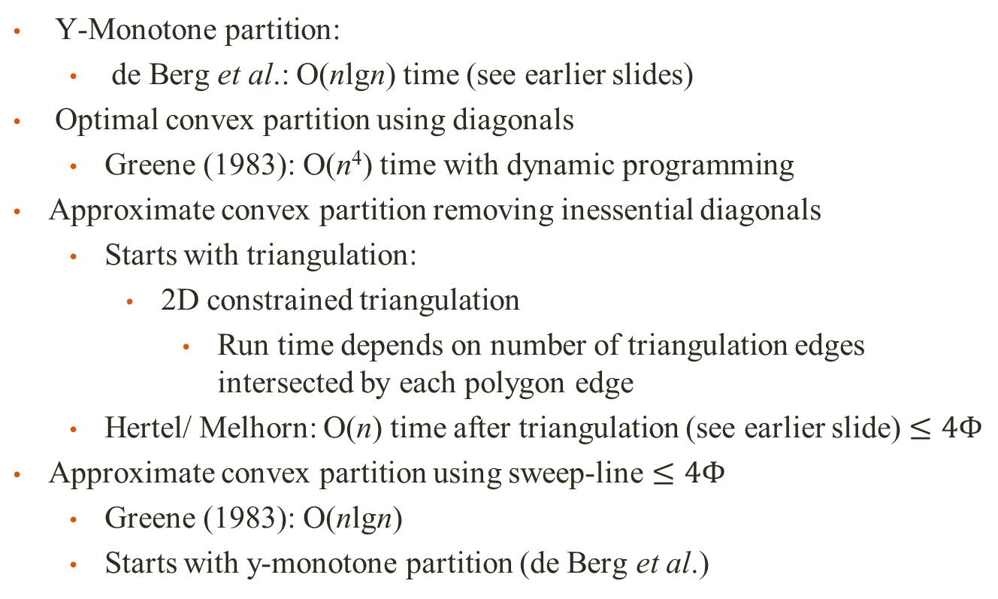
Convex Polygon Partitioning
Y-Monotone partition:
de Berg et al.: O(nlgn) time (see earlier slides)
Optimal convex partition using diagonals
Greene (1983): O(n⁴) time with dynamic programming
Approximate convex partition removing inessential diagonals
Starts with triangulation:
2D constrained triangulation
Run time depends on number of triangulation edges intersected by each polygon edge
Hertel/ Melhorn: O(n) time after triangulation (see earlier slide) $≤4Φ$
Approximate convex partition using sweep-line $≤4Φ$
Greene (1983): O(nlgn)
Starts with y-monotone partition (de Berg et al.)

Slide 11
Applications of convex hull
Fitting ranges with a line. Sheep and goats problem -can you draw a straight line fence that will separate the sheep from the goats? Take the convex hull of each set, if they do not intersect then you can put in a fence. If they intersect, no
Collision problem. Robotics problem - if the convex hulls don't run into each other than the robots won't either.
Smallest box.
Shape analysis

Slide 12
Definitions of convexity and convex hull
The convex hull of a point set is one of the simplest shape approximations for a set of points.
A set S is convex if x ϵ S and y ϵ S implies that the segment xy ⊆ S
convex non-convex

Slide 13
Definitions of convexity and convex hull
The segment xy is the set of all points of the form αx +βy with α ≥ 0, β ≥ 0, and α + β = 1.
A convex combination of points x₁, … , x_{k} is a sum of the form α₁ x₁ + …. + α_{k} x_{k} with

Slide 14
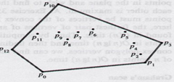
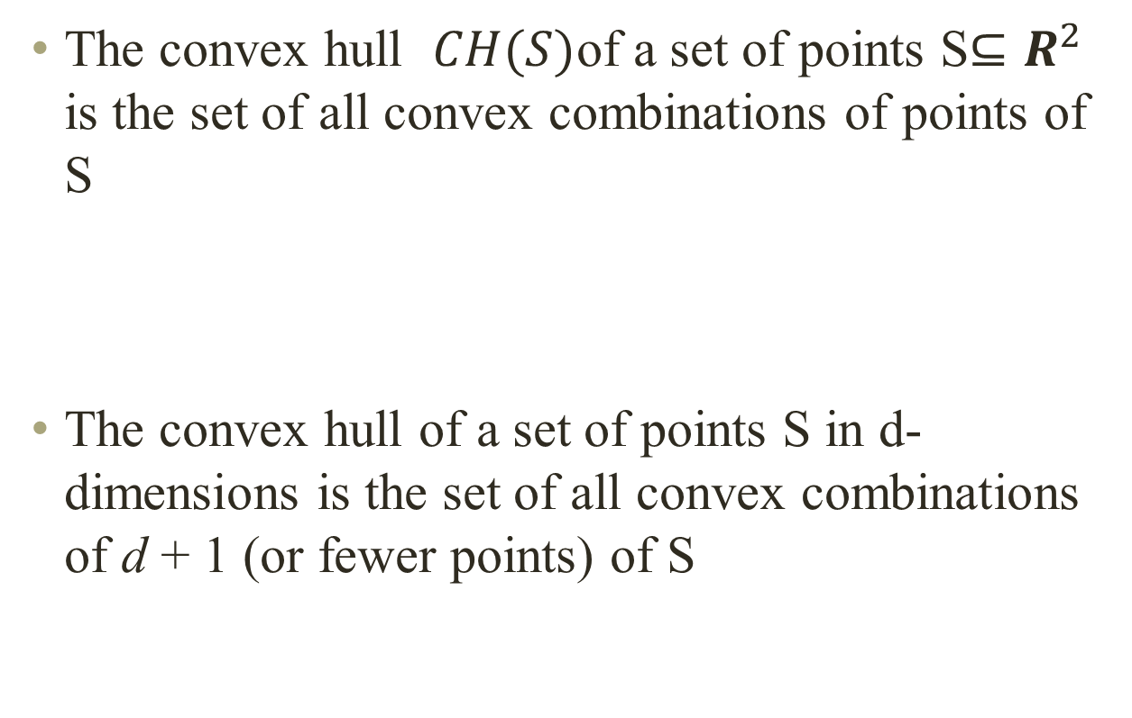
Definitions of convexity and convex hull
The convex hull $CH(S)$of a set of points S$⊆R^{2}$ is the set of all convex combinations of points of S
The convex hull of a set of points S in d-dimensions is the set of all convex combinations of d + 1 (or fewer points) of S

Slide 15
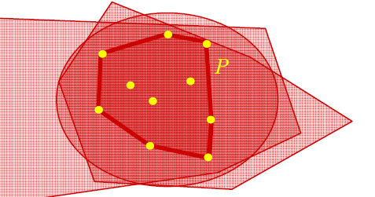
Definitions of convexity and convex hull
The convex hull of a set of points S is intersection of all half spaces that contain S
The convex hull of a finite set of points S in the plane is the smallest convex polygon P that encloses S, smallest in the sense that there is no other polygon P’ such that P ⊇ P’ ⊇ S

Slide 16
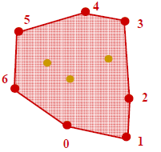

Convex hull
Observation: CH(S) is the unique convex polygon $P$whose vertices are points of S and which contains all points of S.
We represent the convex hull as the sequence of points on the convex hull polygon (the boundary of the convex hull), in counter-clockwise order.
P

Slide 17
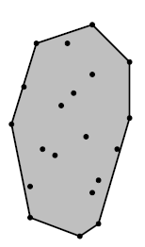
Extreme points
The extreme points of a set S of points in plane are the vertices of the convex hull at which the interior angle is strictly convex, less than π
A set of points S is said to be strongly convex if it consists of only extreme points.

Slide 18
Convex hull problem
Give an algorithm that computes the convex hull of any given set of n points in the plane efficiently
The input has 2n coordinates, so O(n) size

Slide 19
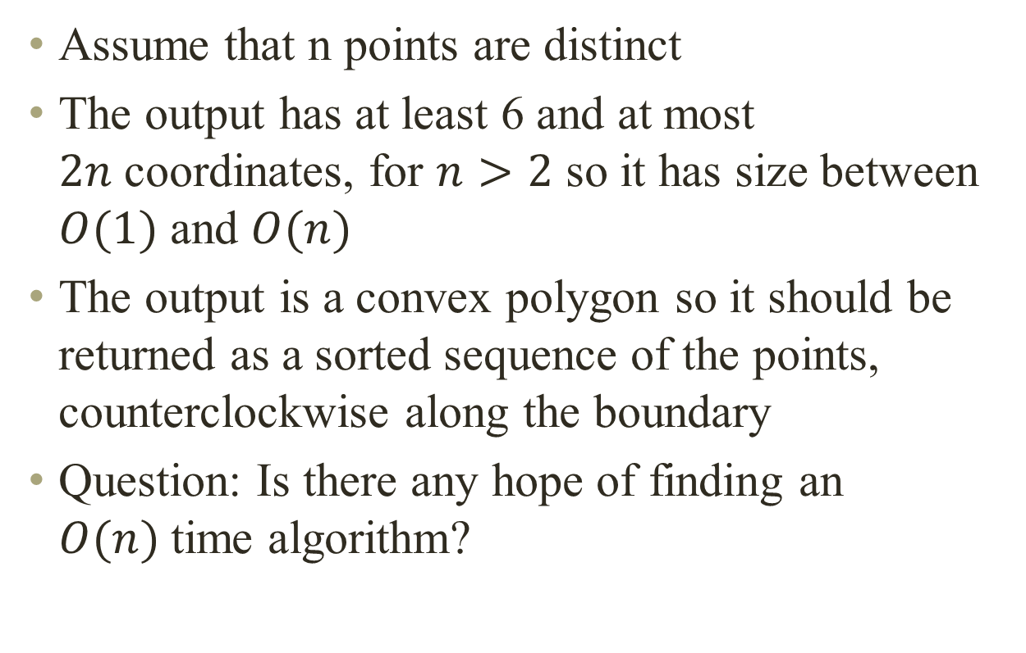
Convex hull problem
Assume that n points are distinct
The output has at least 6 and at most $2n$coordinates, for $n>2$ so it has size between $O(1)$ and $O(n)$
The output is a convex polygon so it should be returned as a sorted sequence of the points, counterclockwise along the boundary
Question: Is there any hope of finding an $O(n)$time algorithm?

Slide 20
Convex hull
Just to make things concrete, we can represent the points by their Cartesian coordinates, in two arrays X[1 :: n] and Y [1 :: n].
We can represent the convex hull as a circular linked list of vertices in counterclockwise order.
If the ith point is a vertex of the convex hull, next[i] is index of the next vertex counterclockwise and pred[i] is the index of the next vertex clockwise; otherwise, next[i] = pred[i] = 0.
It doesn't matter which vertex we choose as the `head' of the list.
The decision to list vertices counterclockwise instead of clockwise is arbitrary.

Slide 21
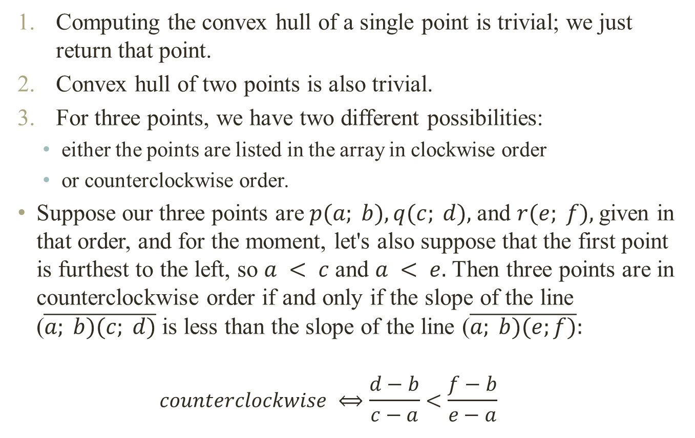
Convex hull orientation
Computing the convex hull of a single point is trivial; we just return that point.
Convex hull of two points is also trivial.
For three points, we have two different possibilities:
either the points are listed in the array in clockwise order
or counterclockwise order.
Suppose our three points are $p(a; b), q(c; d),$and $r(e; f),$given in that order, and for the moment, let's also suppose that the first point is furthest to the left, so $a < c$and $a < e.$Then three points are in counterclockwise order if and only if the slope of the line ($\overline{a; b)(c; d)}$is less than the slope of the line ($\overline{a; b)(e;f)}:$
$$counterclockwise ⟺\frac{d−b}{c−a}<\frac{f−b}{e−a}$$

Slide 22

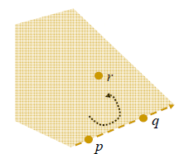
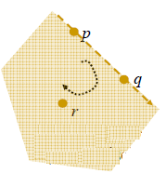

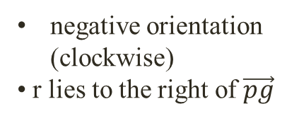
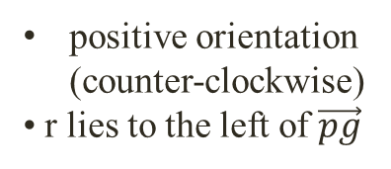
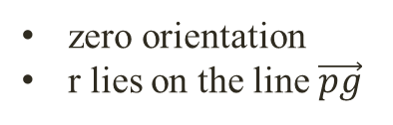
Orientation test
Since both denominators are positive, we can rewrite this inequality as follows:
This final inequality is correct even if (a; b) is not the leftmost point. If the inequality is reversed, then the points are in clockwise order. If the three points are collinear, then the two expressions are equal.
positive orientation (counter-clockwise)
• r lies to the left of $\vec{pg}$
negative orientation (clockwise)
• r lies to the right of $\vec{pg}$
zero orientation
r lies on the line $\vec{pg}$

Slide 23

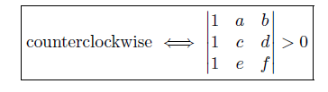
Orientation test
Another way of thinking about this counterclockwise test is that we're computing the cross- product of the two vectors (c; d) - (a; b) and (e; f) - (a; b), which is defined as a 2 x 2 determinant:
We can also write it as a 3 x 3 determinant:
All three boxed expressions are algebraically identical.
Note: This counterclockwise test plays exactly the same role in convex hull algorithms as comparisons play in sorting algorithms. Computing the convex hull of three points is analogous to sorting two numbers: either they're in the correct order or in the opposite order.

Slide 24
Convex Hull: Non-extreme points
A point is non-extreme iff it is inside some (closed) triangle whose vertices are points of the set and is not itself a corner of that triangle.
Algorithm: INTERIOR POINTS
for each i do
for each j ≠ i do
for each k ≠ j ≠ i do
for each l ≠ k ≠ j ≠ i do
if p_{l} in triangle(p_{i}, p_{j}, p_{k})
then p_{l} is non-extreme

Slide 25
Convex Hull: Extreme points
Extreme edges are edges of the convex hull. An edge is extreme if every point of S is on or to one side of the line determined by the edge.
Algorithm: Extreme points
for each i do
for each j ≠ i do
for each k ≠ j ≠ i do
if p_{k} is not left or on (p_{i}, p_{j})
then (p_{i}, p_{j}) is not extreme

Slide 26
Convex Hull: Jarvis's Algorithm (Gift-Wrapping)
The simplest algorithm for computing convex hulls simply simulates the process of wrapping a piece of string around the points.
This algorithm is usually called Jarvis's march, but it is also referred to as the gift-wrapping algorithm.
Jarvis's march starts by computing the leftmost point, i.e., the point whose x-coordinate is smallest, since we know that the left most point must be a convex hull vertex.
Finding the left most point clearly takes linear time

Slide 27
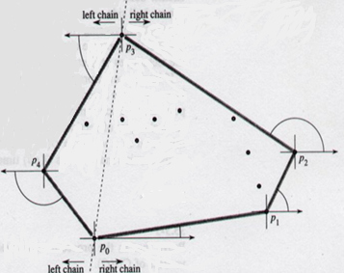
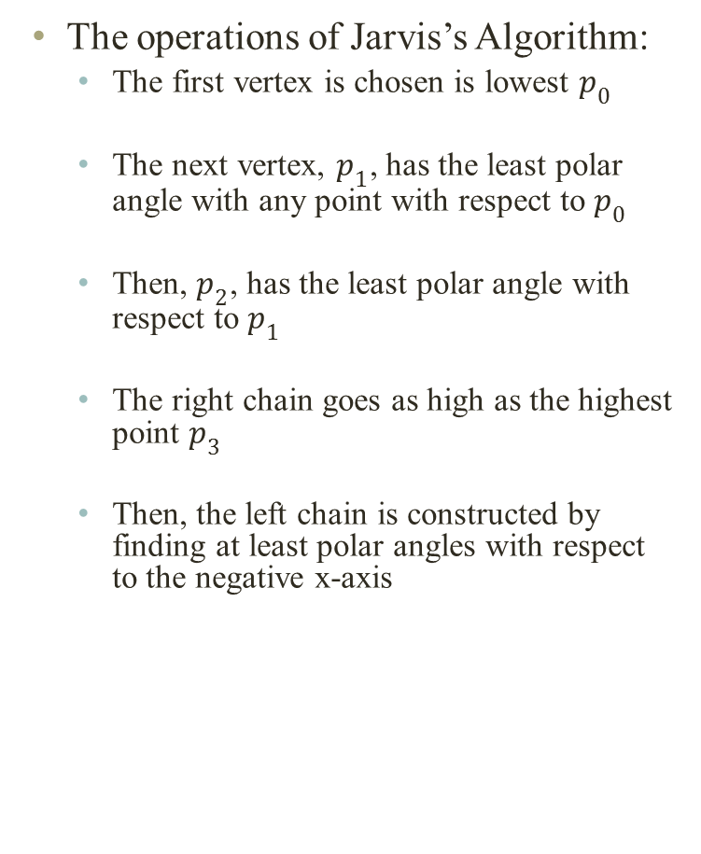
2D Gift Wrapping
The operations of Jarvis’s Algorithm:
The first vertex is chosen is lowest $p_{0}$
The next vertex, $p_{1}$, has the least polar angle with any point with respect to $p_{0}$
Then, $p_{2}$, has the least polar angle with respect to $p_{1}$
The right chain goes as high as the highest point $p_{3}$
Then, the left chain is constructed by finding at least polar angles with respect to the negative x-axis

Slide 28

2D Gift Wrapping
Step 1: Let $p$ be the point with minimum
x-coordinate
Step 2: Anchor ray at current point
and rotate to next anchor point.
Repeat step 2
p
p
p
p
p
p
p

Slide 29
2D Gift Wrapping
Step 1: Let p₁ be the point with minimum
y-coordinate
Step 2: Anchor ray at current point
and rotate to next anchor point.
Repeat step 2
p₄
p₃
p₅
p₂
Ray
p₁
O(n²)

Slide 30
2D Gift Wrapping
Assumption: Assume a general position of the points:
No three points are collinear
θ
Algorithm: GIFT WRAPPING
i₀ ← index of the lowest point
i ← i₀
repeat
for each j ≠ i do
Compute counterclockwise angle θ from previous hull edge
k ← index of point with smallest θ
Output (p_{i} , p_{k}) as a hull edge
i ← k
until i = i₀

Slide 31
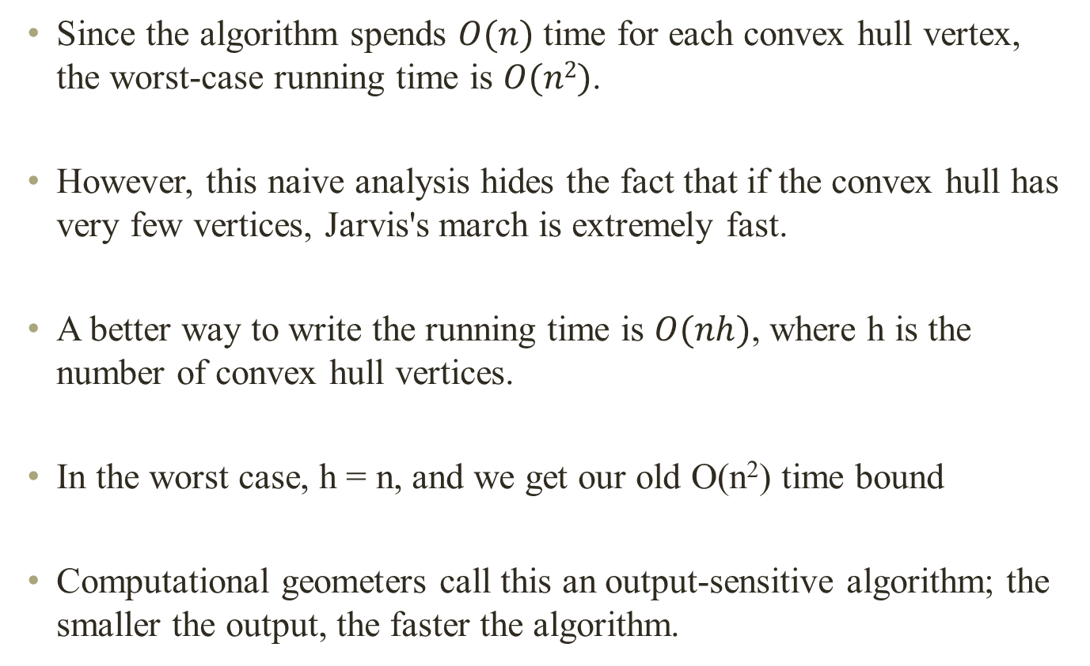
2D Gift Wrapping
Since the algorithm spends $O(n)$ time for each convex hull vertex, the worst-case running time is $O(n2)$.
However, this naive analysis hides the fact that if the convex hull has very few vertices, Jarvis's march is extremely fast.
A better way to write the running time is $O(nh)$, where h is the number of convex hull vertices.
In the worst case, h = n, and we get our old O(n²) time bound
Computational geometers call this an output-sensitive algorithm; the smaller the output, the faster the algorithm.

Slide 32
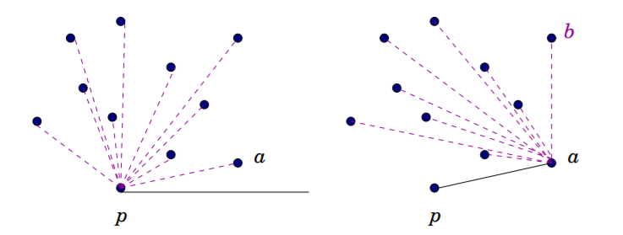

Gift Wrapping
Start with bottom point $p$.
Angularly sort all points around $p$.
Point a with smallest angle is on CH.
Repeat algorithm at $a$.
Complexity $O(Nh); 3 ≤ h = |CH| ≤ N.$Worst case $O(N^{2})$.

Slide 33

Example

Slide 34
Example

Slide 35
Example

Slide 36
Example

Slide 37
Example

Slide 38
Example

Slide 39
Example

Slide 40
Example

Slide 41
Example

Slide 42
Example

Slide 43
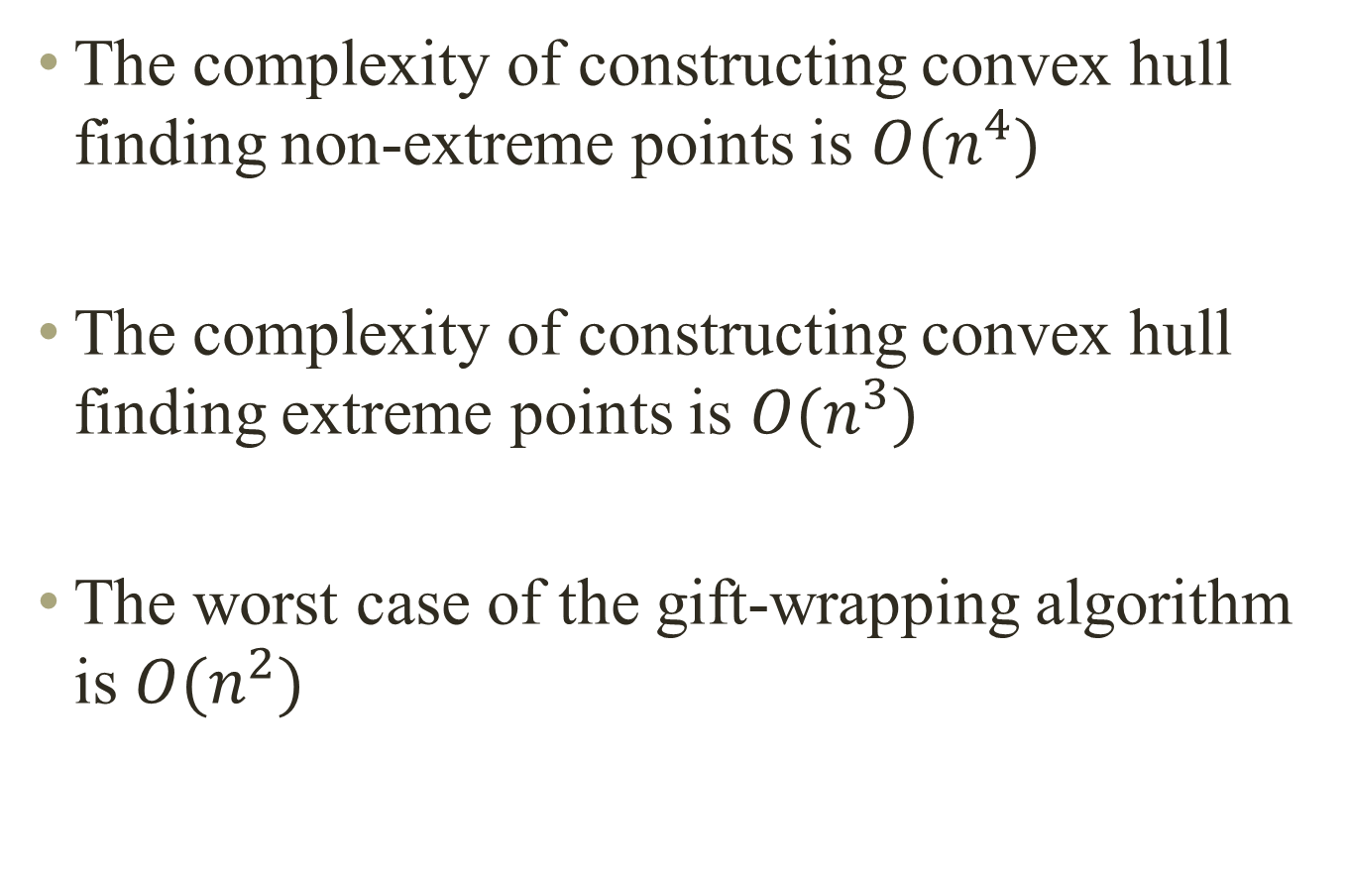
Summary
The complexity of constructing convex hull finding non-extreme points is $O(n^{4})$
The complexity of constructing convex hull finding extreme points is $O(n^{3})$
The worst case of the gift-wrapping algorithm is $O(n^{2})$

Slide 44
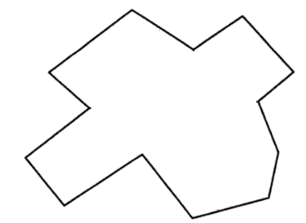
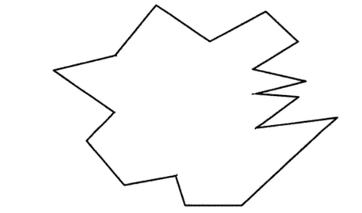
Question
Verify experimentally (for examples given below) that the result produced by the Hertel-Melhorn algorithm is a convex partition using diagonals. Check if the number of convex pieces is truly ≤ 4 Φ.

Slide 45
Question
2. Modify the algorithm so that it works properly without the general position assumption

